Slide 1
Assignment Day Extra Class 2 - Web Dashboard Development using Tableau
File created on: 7/7/2026 5:08:46 AM

Slide 2


Slide 3


Slide 4


Slide 5
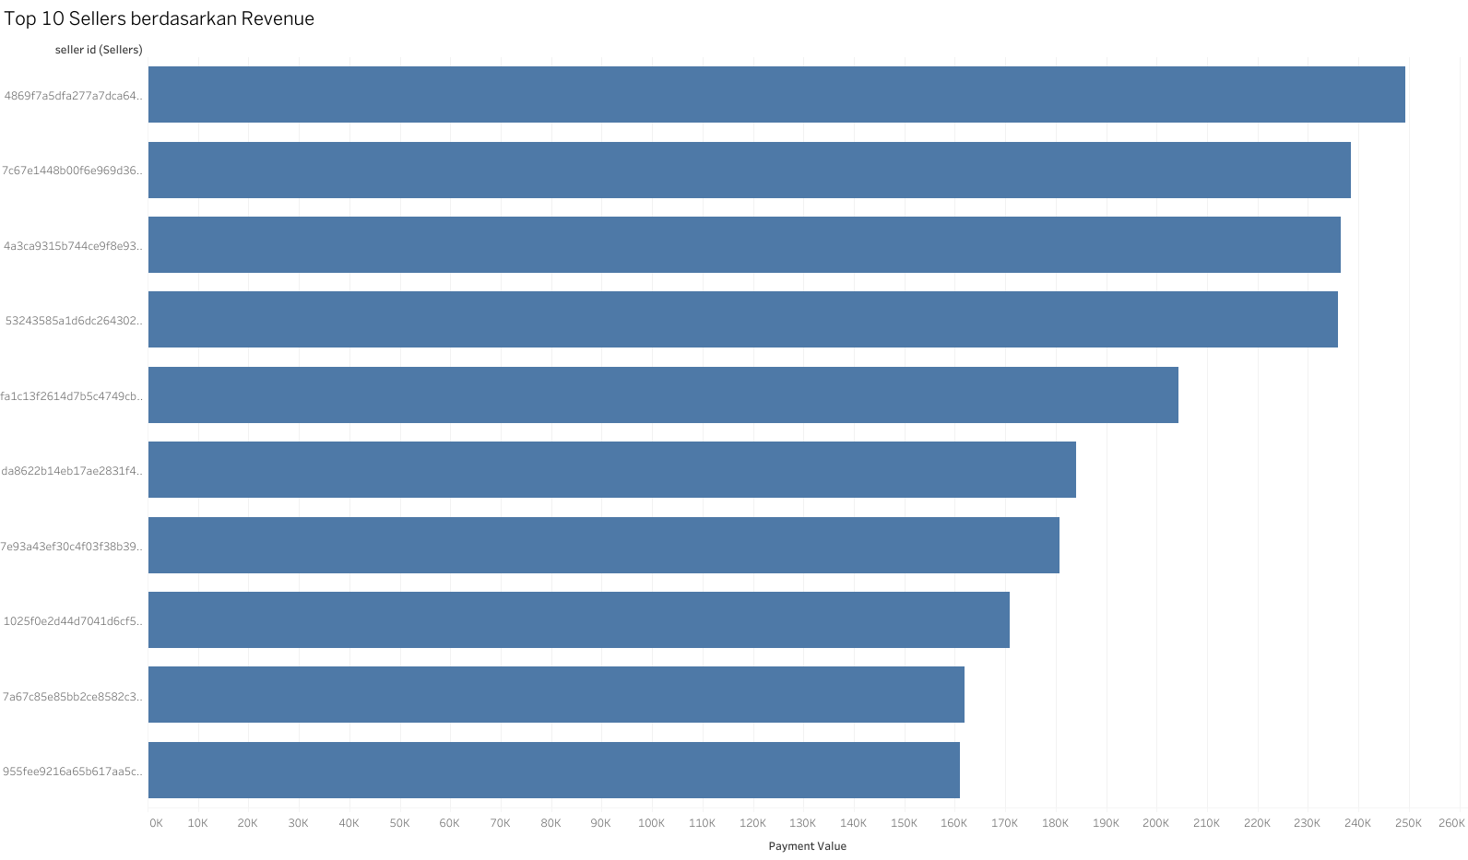

Slide 6
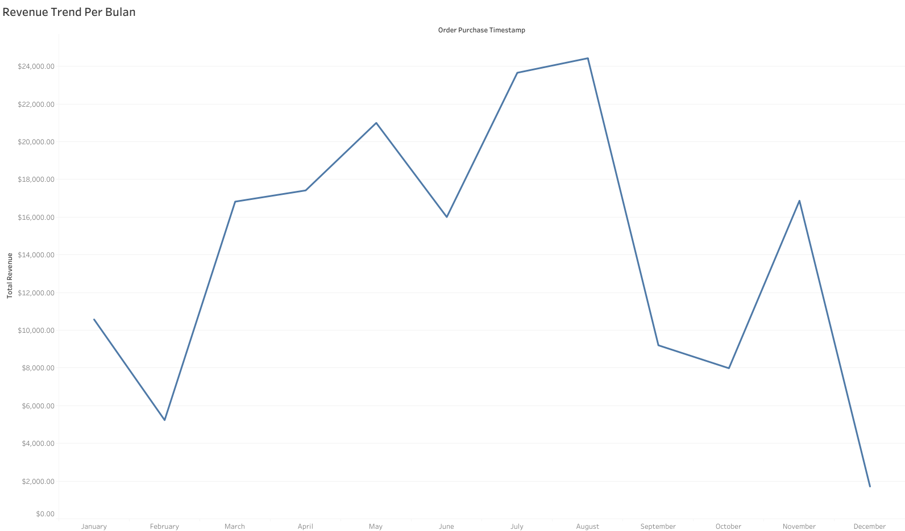

Slide 7
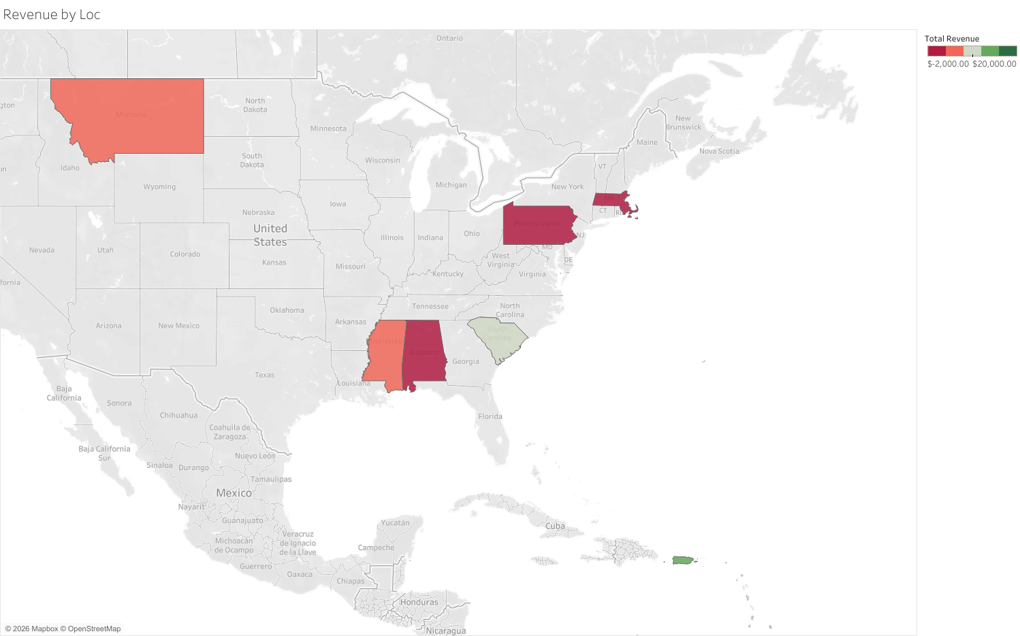

Slide 8
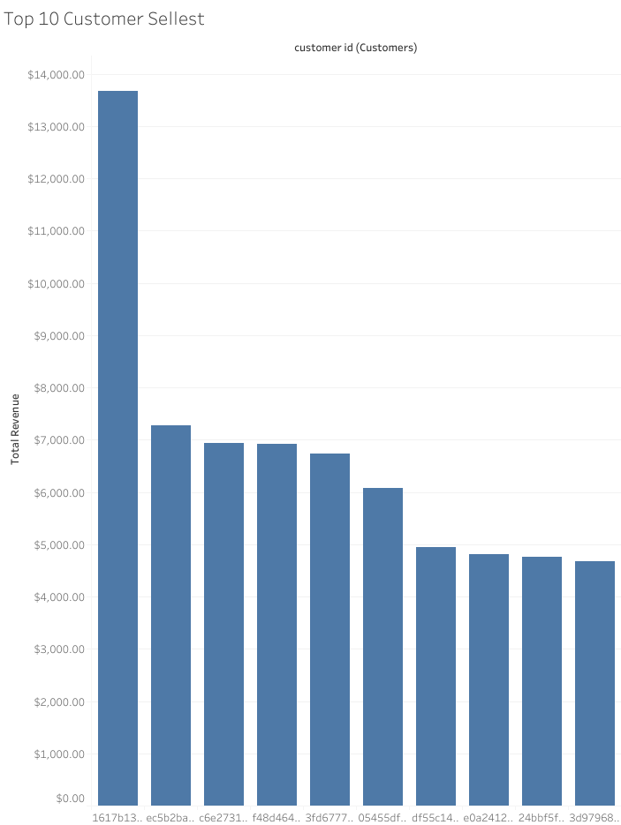

Slide 9
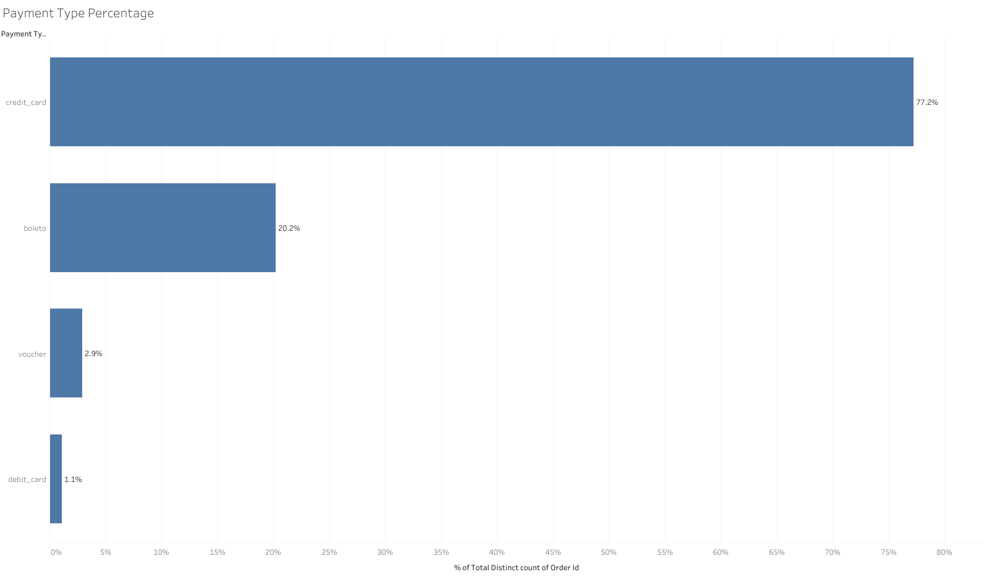

Slide 10
